Slide 1
Digital Health Literacy and Trust in Healthcare Systems
An Analysis of the ISSP 2021 Global Dataset
Made by: Yehonatan Segev, Ori Cohen

Slide 2
Research Focus
This project investigates the relationship between internet reliance and healthcare confidence
Our key Research Question:
The Digital Divide: How do Age, Gender and Location influence health information seeking
The Trust Gap: Does low confidence in system drive patients look for answer online ?
User Personas: Can we Identify distinct groups of digital health users using Clustering ? (Unsupervised Learning)
Global Context: How does this vary across different nations

Slide 3
Data & methodology
Data Processing :
Scale Reversal : Inverted scales so “Higher Number = Higher confidence/Frequency” for intuitive analysis
Demographics : Extracted and binned age groups, gender, and Urban/Rural status.
Modeling : Moved from supervised (KNN) to unsupervised learning (K-Means Clustering) to find natural user patterns.
Source: ISSP 2021 Health and Health care II
Key Variables: Confidence (v2), Internet Freq (v22), Verification (v29), Satisfaction (v44/v45)

Slide 4
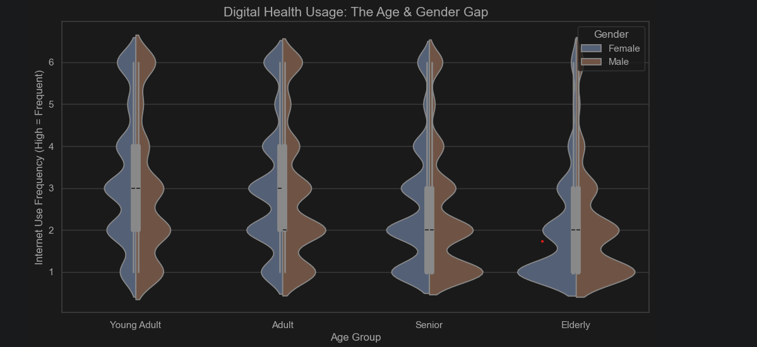
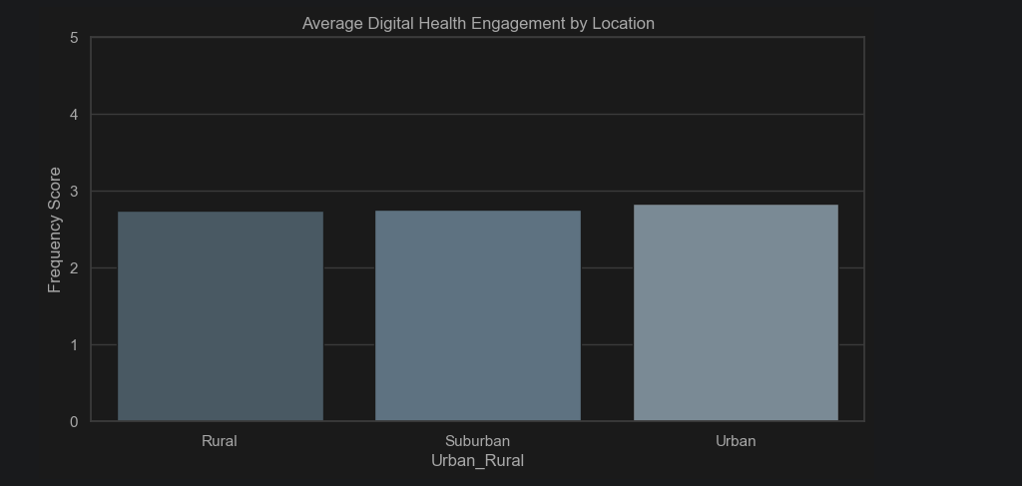
Insight 1 –
The Demographic Divide
Key Findings :
Age is the primary driver: “Young Adults” are the heaviest users of digital health info
The Gender gap: Females tend to search for more health info
Location: Urban residents show higher digital engagement by a small margin
Takeaway: Digital health literacy is not uniform, its heavily skewed by demographics

Slide 5
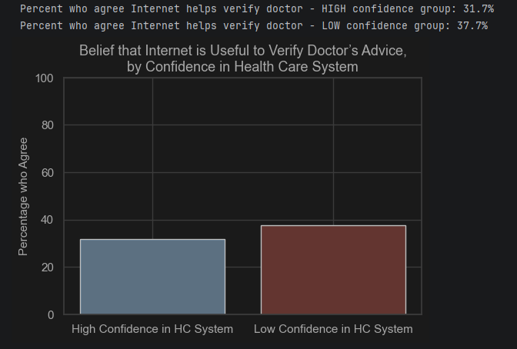
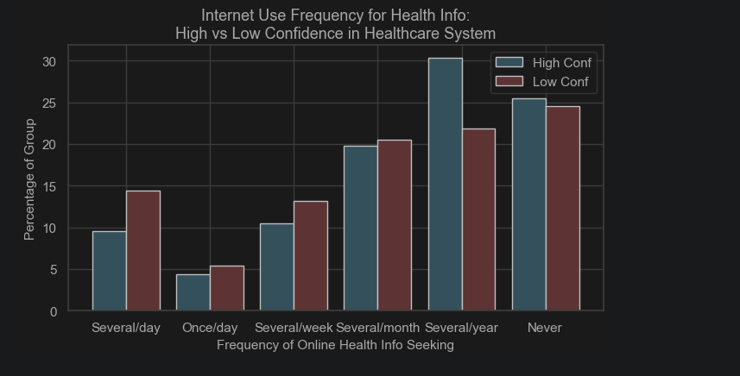
Insight 2 –
The Trust paradox
Key Findings :
The Skeptic’s Tool: Individuals with low Confidence in healthcare system are significantly more likely to use the internet to “double- check” their doctor.
Behavioral Split: High-trust individuals often report “Never” or “Serval\year” using the internet for health, relaying entirely on the system.
Conclusion: There is a clear Inverse Correlation – distrust in the system drives digital verification.

Slide 6
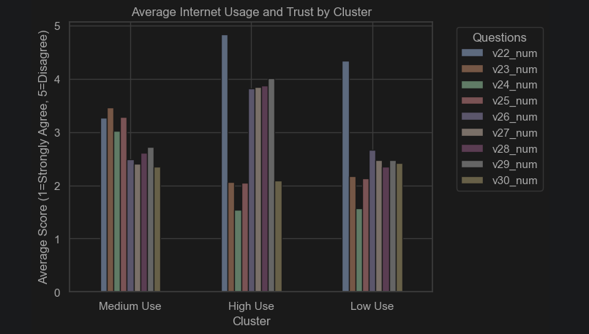
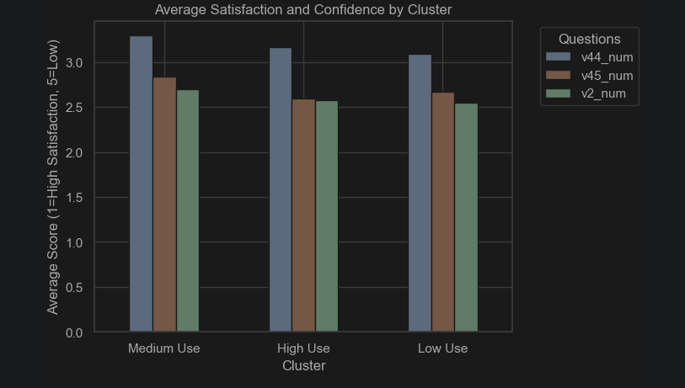
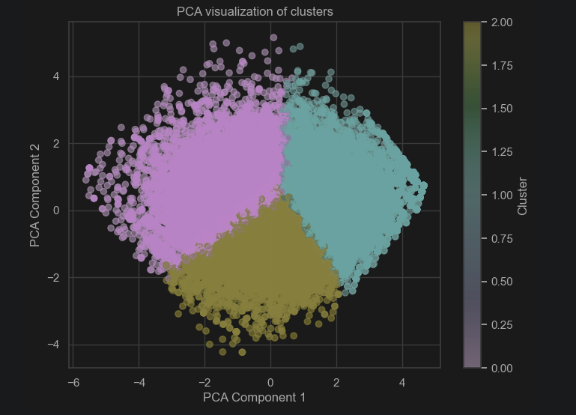
Insight 3 –
Identifying user personas
The Approach:
We tried to predict via usage of KNN (Supervised) but what we got which was Low accuracy suggests the behavior is more complex.
So to face this issue we switch to K-means Clustering (unsupervised) to let the data reveal natural groups.
The Surprise:
Finding: Despite different digital behaviors, satisfaction is relatively uniform across all clusters.
Meaning: High internet use does not automatically mean a person is dissatisfied. The relationship is nuanced

Slide 7
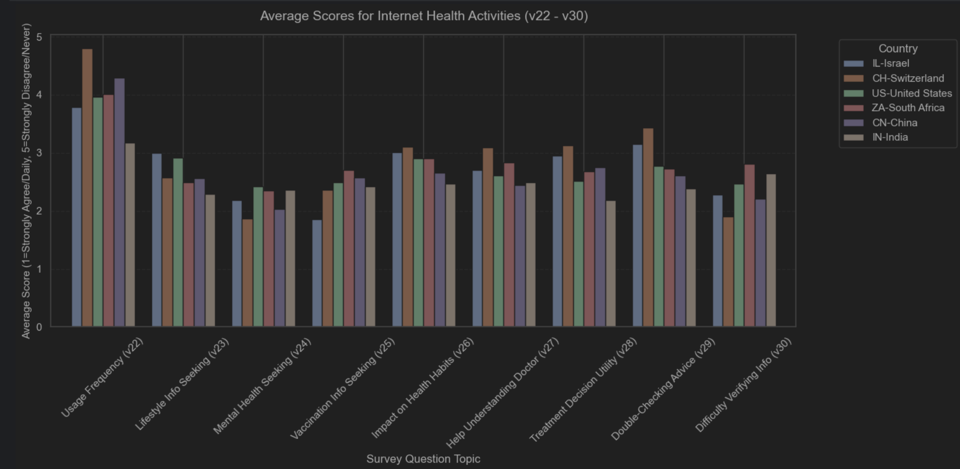
Global Perspectives

Slide 8
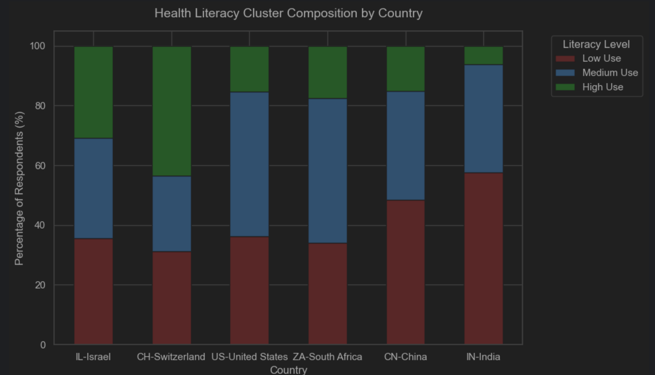
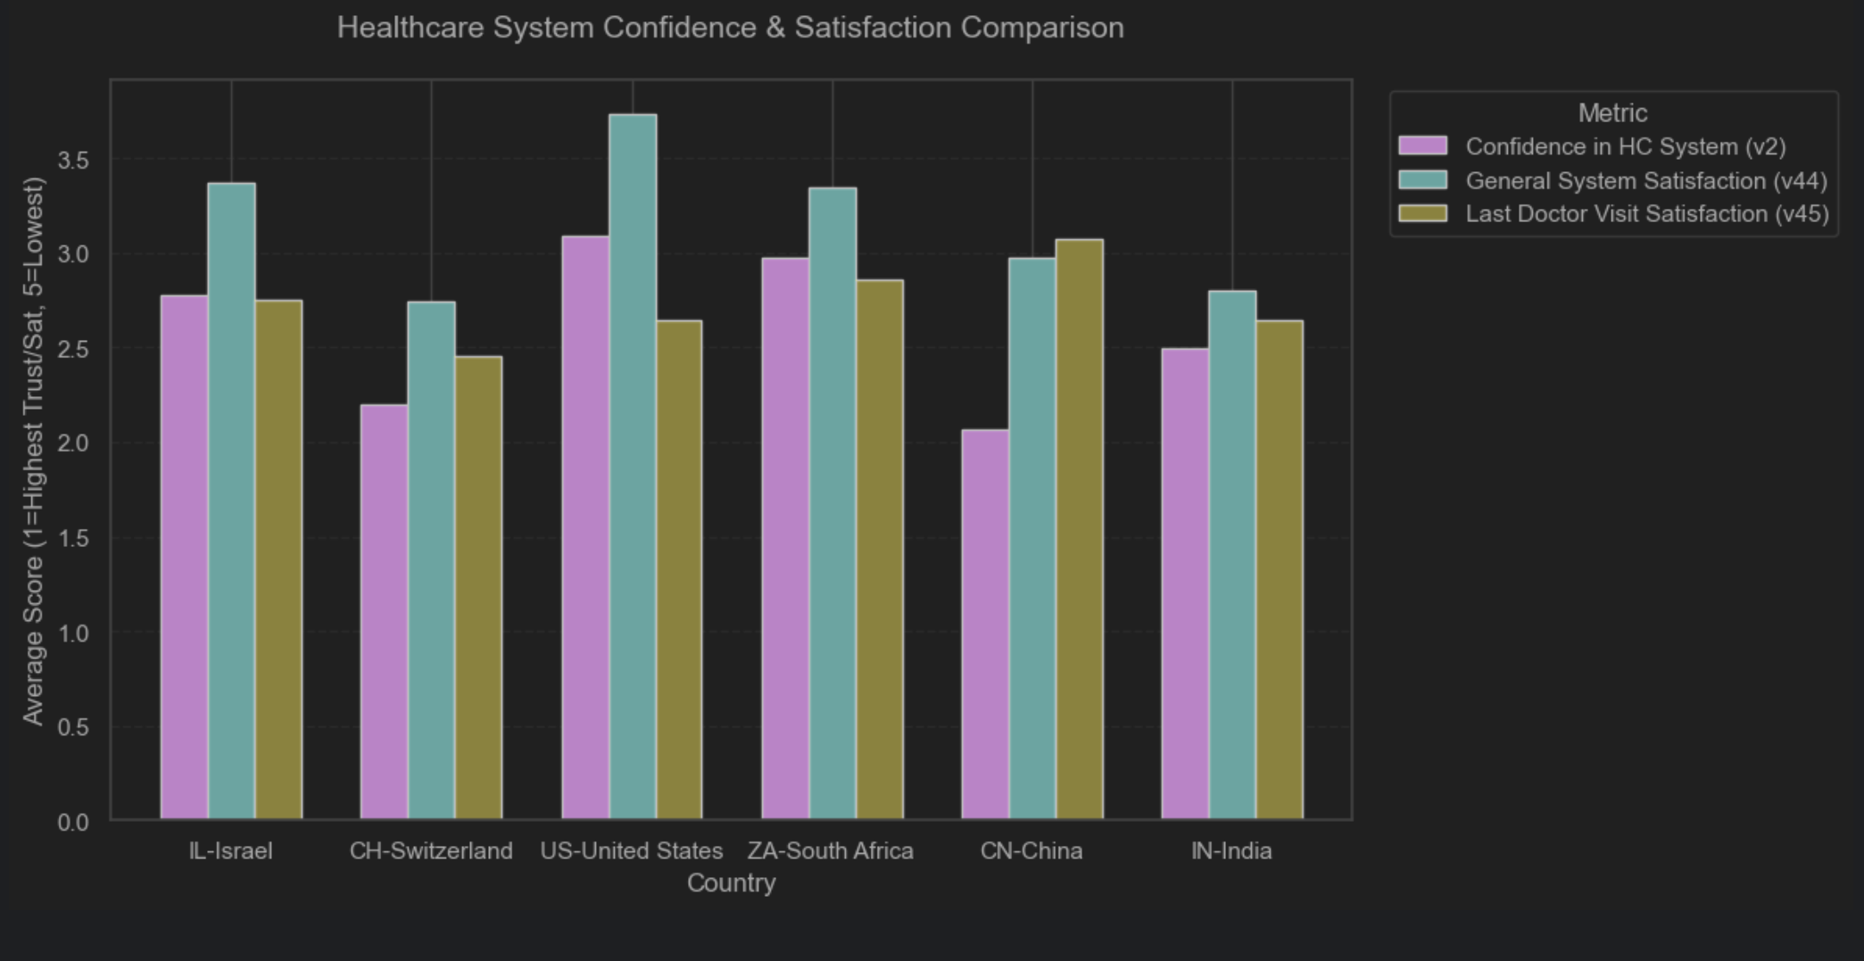
Global Perspectives
Key Findings :
Some nations have high digital engagement but moderate to low system confidence
We see lower internet usage with varying levels of trust
Advance digital infrastructure does not guarantee higher trust in the healthcare system. In fact, easier access to information often correlates with more critical views of the system
Takeaway: :”Digital health” is not just about technology availability, it’s a cultural response to how citizens view their institutions

Slide 9
Conclusions
Summary of Findings:
The Digital Divide is Demographic: Age is the strongest predicator of usage. Young adults are “Digital Natives” in healthcare, while seniors remain “Analog Loyalists” despite having higher health care needs.
The Trust Paradox Confirmed: We found a statistically significant link- Low confidence in the healthcare system drives patients to the internet. As the internet provides a good “second option” for skeptics.
Behavior ≠ Satisfaction: Our clustering revealed that High Frequency users aren’t necessarily dissatisfied, they are simply informed.
We can infer that they use the internet to navigate the system, not just replace it.
Implications for Healthcare:
Don’t fight the GPT: Since low-trust groups flock online, healthcare systems must improve their official digital presence to combat misinformation.
Target the “Verifier”: Doctors should expect and encourage digital verification to build trust with skepticism-prone demographics

